Slide 1
Data visualization
29.03.2022

Slide 2
agenda
Definition of Taxonomy
Taxonomy by Keller and Keller
Taxonomy by KEIM
Taxonomy Shneiderman

Slide 3
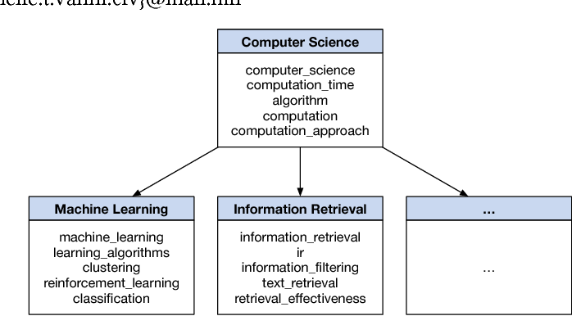
taxonomy
Taxonomy represents the foundation upon which information architecture stands, and all well-rounded developers should have at least a basic understanding of taxonomy to ensure that they can create organized, logical applications.

Slide 4
taxonomoies
A taxonomy is a means to convey a classification.
Often hierarchical in nature, a taxonomy can be used to group similar objects and define relationships.
In visualization, we are interested in many forms of taxonomies, including data, visualization techniques, tasks, and methods for interaction.

Slide 5
Taxonomy of Visualization Goal by keller and keller
Keller and Keller, in their book Visual Cues [205], classify visualization techniques based on the type of data being analyzed and the user’s task(s).
Similar to those identified earlier in this book, the data types they consider are:
• scalar (or scalar field);
• nominal;
• direction (or direction field);
• shape;
• position;
• spatially extended region or object (SERO).

Slide 6
Contd.
The authors also define a number of tasks that a visualization user might be interested in performing.
While some of the tasks seem interrelated, their list is a useful starting position for someone setting out to design a visualization for a particular application. Their task list consists of:

Slide 7
Task list
• identify—establish characteristics by which an object is recognizable;
• locate—ascertain the position (absolute or relative);
• distinguish—recognize as distinct or different (identification is not needed);
• categorize—place into divisions or classes;
• cluster—group similar objects;
• rank—assign an order or position relative to other objects;
• compare—notice similarities and differences;
• associate—link or join in a relationship that may or may not be of the same type;
• correlate—establish a direct connection, such as causal or reciprocal.

Slide 8
Data Type by Task Taxonomy BY Shneiderman
A related strategy was proposed by Shneiderman [319].
His list of data types was somewhat different from Keller and Keller’s, and included more types from the information visualization field.
His list of data types consisted of:
• one-dimensional linear;
• two-dimensional map;
• three-dimensional world;
• temporal;
• multidimensional;
• tree;
• network

Slide 9
Contd.
For his tasks, Shneiderman looked more at the behavior of analysts as they attempt to extract knowledge from the data. His task set consisted of the following
Overview. Gain an overview of the entire collection, e.g., using a fisheye strategy for network browsing.
Zoom. Zoom in items of interest to gain a more detailed view, e.g., holding down a mouse button to enlarge a region of the display.
Filter. Filter out uninteresting items to allow the user to reduce the size of a search, e.g., dynamic queries that can be invoked via sliders.
Details-on-demand. Select an item or group and get details when needed, e.g., a pop-up window can show more attributes of a specific object on the screen

Slide 10
Contd.
Relate. View relationships among items, e.g., select a particular object that can then show all other objects related to it.
History. Keep a history to allow undo, replay, and progressive refinement, such as allowing a mistake to be undone, or a series of steps to be replayed.
Extract. Extract the items or data in a format that would facilitate other uses, i.e., saving to file, sending via e-mail, printing, or dragging into another application (statistical or presentation package).
Shneiderman suggested that an effective visual exploration tool should support most or all of these tasks in an easy-to-use manner.

Slide 11
Keim taxonomy
Keim designed a classification scheme for visualization systems based on three dimensions: data types, visualization techniques, and interaction, distortion methods.
Classification of Data Types. 6 types of data exist:
1. One-dimensional data—i.e., temporal data, news data, stock prices, text documents
2. Two-dimensional data—i.e., maps, charts, floor plans, newspaper layout.
3. Multidimensional data—i.e., spreadsheets, relational tables
4. Text and hypertext—i.e., new articles, web documents
5. Hierarchies and graphs—i.e., telephone/network traffic, system dynamics models 6. Algorithm and software—i.e., software, execution traces, memory dump

Slide 12
Classification of Visualization Techniques.
5 classes of visualization techniques exist:
1. Standard 2D/3D displays—i.e., x, y- or x, y, z-plots, bar charts, line graphs;
2. Geometrically-transformed displays—i.e., landscapes, scatterplot matrices, projection pursuit techniques, prosection views, hyperslice, parallel coordinates;
3. Iconic displays—i.e., Chernoff faces, needle icons, star icons, stick figure icons, color icons, tilebars;
4. Dense pixel displays—i.e., recursive pattern, circle segments, graph sketches;
5. Stacked displays—i.e., dimensional stacking, hierarchical axes, worlds-within-worlds, treemaps, cone trees

